Slide 1
Segmenting and Clustering Calgary Neighbourhoods Based on Current Real Estate and Location Information
By Moriah Rempel

Slide 2
Help Buyers find a home using Neighbourhood Clusters
Finding the perfect home can be a challenge as there are many different factors to consider when purchasing a home.
Clustering can be used to group Calgary neighbourhoods with similar real estate and venue traits
Buyers can be paired to these clusters to help them narrow down the neighbourhoods they are searching for homes in

Slide 3
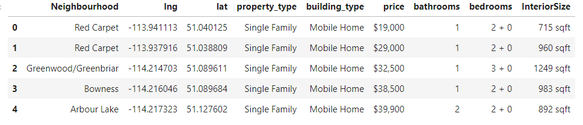
Data
Real Estate Data retrieved from realtor.ca using an API

Slide 4
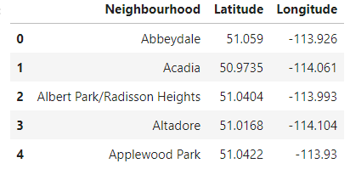
Data
Neighbourhood list scraped from Wikipedia with coordinates found by averaging coordinates from neighbourhood listings in the real estate dataframe

Slide 5
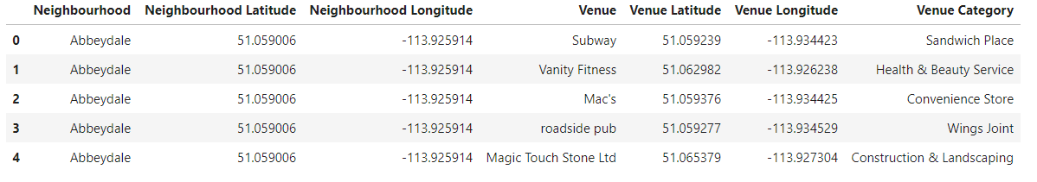
Data
Neighbourhood venue data retrieved off Four Square using the API

Slide 6
K-means Clustering
define a set number of clusters
randomly distributing the set number of cluster centroids throughout the data
data is assigned to the nearest cluster centroid
the average of the data within the cluster is found and the centroid is moved to the average.
Repeat assigning data and averaging until there is no change in the centroid location.

Slide 7
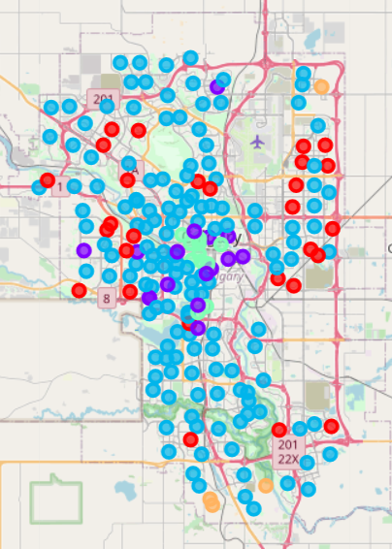
K-means Clustering Neighbourhoods using Venue Data
K-means clustering of neighbourhoods performed using the venue data
Top 5 venues
Number of venues

Slide 8
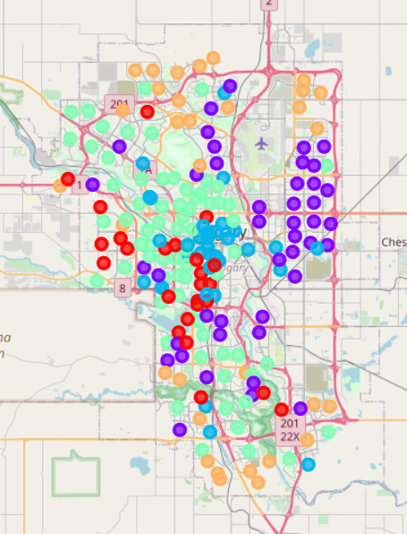
K-means Clustering Neighbourhoods using Real Estate Data
K-means clustering of neighbourhoods performed using the real estate data
Building type (house, apartment, etc)
Price
Number of Bathrooms
Number of Bedrooms
Interior Size (sqft)

Slide 9
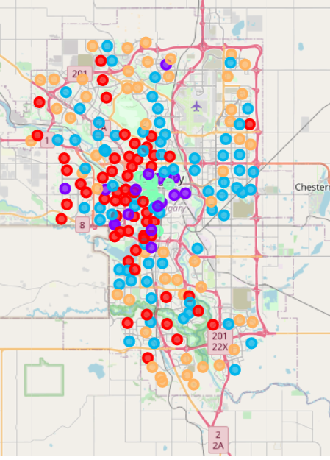
K-means Clustering Neighbourhoods using both Venue and Real Estate Data
K-means clustering of neighbourhoods performed using a combination of the venue and real estate data mentioned previously

Slide 10
Results
5 Clusters created
Expensive and big houses, few venues
Less Expensive apartments and townhouses, good amount of venues
Less expensive, smaller houses, few venues
Mid-priced apartments and townhouses, in city core with lots of venues
Mid-priced, mid-sized houses, few venues

Slide 11
Conclusion
Neighbourhoods clustered into 5 groups based on real estate and venue data
Future directions
Split data by building type to find most and least expensive neighbhourhoods by comparing similar listings
Incorporate transit data

